Slide 1
Agenda
1. Common Terms
2. How is content scored
3. Ally Report – historical vs actual

Slide 2
Common Terms
File Sync - Scanning the clients SAN folder and creating the database entries in the cms.File table
Content Sync - Scanning the clients database tables for file references and adding those references in the cms.FileReference table
Onboarding - Loading the clients public facing end user site into the Ally product through WCM's APIs and giving the client an initial accessibility score
Continuous Evaluation - Continuous data check through the Task Scheduler Services for updated content that gets sent to Ally for updated accessibility scores

Slide 3
How Does Ally Work?

Slide 4
File Sync
Independent from Ally
Sets the SyncStartDate on start
Scans the SAN at the root centricity folder (cms.setting table)
Kicks off Content Sync job if successful

Slide 5
Content Sync
Independent from Ally
Scans client database for File References in the content
Sets cms.setting.filesyncenddate when finished
Inserts AllyReferences for Pages, Detail Pages, and Files

Slide 6
AllyReference – Table
Id – Unique Identifier used by Ally
RecordID – ID of the Type being referenced (PageID,FileID,etc)
PageModuleInstanceID – Detail pages only, tells us which App the detail page is for
Type – Page, File, Detail Page

Slide 7
Services Workflow – Ally Event Post Job
Posts Events to Ally for processing
Gets batch of events in the Ally Event Queue (FIFO)
Batch limit determined by OnPeak/OffPeak times
Loops through Accounts and posts events for that specific account
Updates the AllyEventQueue based on HTTP Response from Ally

Slide 8
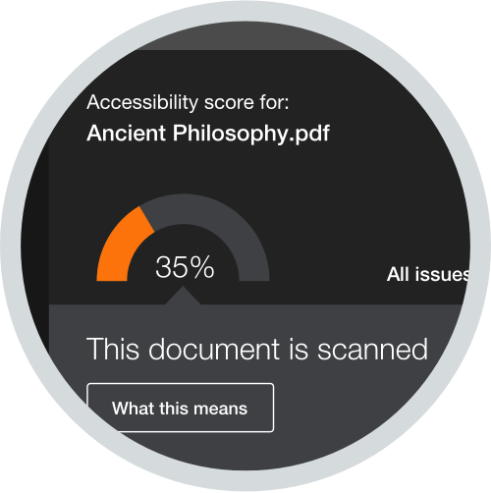
Ally - How is content scored
Gathers changes on client database and places change events in AllyEventQueue
Uses clients LastContentSyncDate as a starting point to scan for changes
Scans the following areas for a modified/created date greater than LCSD:
Page,FlexData ,Page File (background imagery) ,File ,Calendar ,Assignment ,Delete ,Moved Channel/Sections ,Moved Pages, Undeletes (Recycle bin restores, inactive to active)
Processes Changes in batches
Checks to make sure Ally Client ID/secret/key is populated to grab changes
Inserts into AllyEventQueue
Injects files on a page and scores with a custom version of aXe
Updates Client LastContentSyncDate to current time

Slide 9
Review
A client makes a change to a page
We see that the time stamp has changed and send it to Ally
Ally injects the files on a webpage and scans it with a custom version of aXe
Ally scores the page and updates the score in the report

Slide 10
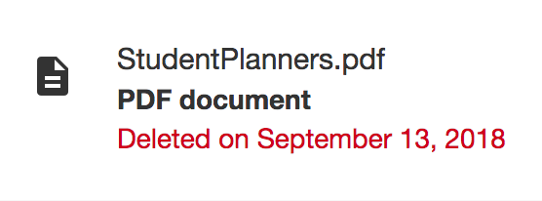
Ally Report – Historical vs Actual
Ally found that users in a LMS environment preferred historical scoring to see how they have progressed through time. This leads to confusion in the following areas:
Ally Report – defaults to the historical view at the org level
Ally report – defaults to the current view at the section level
Ally report – allows users to change the school year, which begins on September 1
User will need to toggle through all years to view all active issues
Ally report will show deleted files in the historical view.
Users must add &historical=true or &historical=false to the url to change the view
WCM widget – defaults to the current view and shows all issues regardless of the year

Slide 11
FAQ
How often does Ally scan the site
Ally will scan the page when content is updated.
Does Ally scan Files &. Folders
No, Ally works like a screen reader and will only scan content on a page that is available for the public to see
I made changes and they aren't being updated in my report. Why aren't they showing up?
The Queue is backed up and the change has not been sent to Ally yet.
The EventQueue is First In, First Out, so if a lot of people are making changes, it all depends on where you fall in line.
Your change did not get picked up by our Change Service that scans for changes.
There may be DB errors. A Developer will need to work on this

Slide 12
FAQ Part 2
I'm seeing "Content Sync In Progress" on my workspace and it has been like that for a while.
Load up the browsers console (F12) and reload the page. Look on the "Console" tab and see if there are any errors on the call to Ally.
Make sure the call to Ally is going to https://prod.ally.ac. If it is anything different, it is pointed at the wrong server which is why you seeing the "Sync in Progress" message. This needs changed by hosting in the web.config entry.
Make sure the cms.Domain record for the Ally Key/Secret/ClientID is correct. If one of these values is incorrect, it will most likely give you a "401: unauthorized" error message
I deleted a file, but it is still showing in my report
Does it link to a protected page? If so the user deleted the file from the page, but the app is still active

Slide 13
Questions?

